Slide 1
Community Transportation Initiatives in New Jersey
Anna R. Magri, Director
Office of Local Programs/Minibus Support & Community Transportation
January 30, 2018

Slide 2
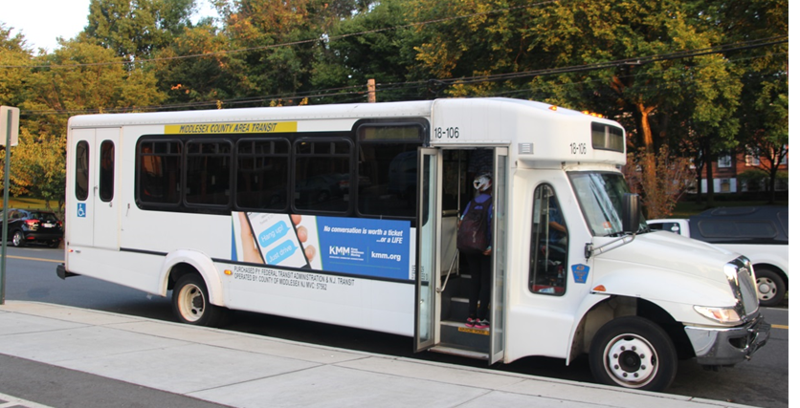
Local Programs/Minibus Support & Community Transportation
Our Mission - To provide improved accessibility and mobility for the state’s senior citizens and persons with disabilities through the development of a coordinated and seamless statewide community transportation network.

Slide 3
What do we do?
Administer $44M annually in State and FTA grants and programs throughout New Jersey.
Coordinate local efforts with NJ TRANSIT’s own operations and that subrecipients participate in the locally developed Coordinated Human Services Transportation Plans (CHSTP)
Provide technical support and best practices to our subrecipients.
Administer all grants in accordance with FTA and State regulations.

Slide 4
Community Transportation Services
Demand Response services for seniors and persons with disabilities that requires a reservation
Route deviation shuttle services that deviate off route to serve trip origins and destinations that are not directly served
Feeder to NJ TRANSIT bus and rail stations
Support Van pool in coordination with TMAs

Slide 5
Grant Programs We Administer
Senior Citizen and Disabled Resident Transportation Assistance Program (SCDRTAP)
FTA Section 5310 Enhanced Mobility of Seniors and Individuals with Disabilities
FTA Section 5311 Formula Grants for Rural Areas
NJ Job Access Reverse Commute (NJ JARC)
Congestion Mitigation and Air Quality Improvement (CMAQ) – FTA Section 5307

Slide 6
SCDRTAP
Senior Citizen and Disabled Resident Transportation Assistance Program (SCDRTAP)
Trip Types
Medical
Non-Competitive Employment
Competitive Employment
Shopping
Recreation
Dialysis
Education (college)
Other – shuttles and general public

Slide 7
Funding History

Slide 8
FTA Section 5310
Annual competitive formula grant
Eligible activities include operating, capital and mobility management
Mobility Management Projects include
Equipment and/or Planning
Travel Training for Seniors and PWD
NJT provides the 20% required local match for capital
Subrecipients provide the 50% required match for Operating projects

Slide 9
FTA Section 5311
Currently there are 15 Section 5311 projects
NJT provides half of the local match required for administration and operating projects which is approximately $1.6M in NJT operating funds.
In 2015 Section 5311 Innovation grant was implemented for agencies to develop deviated route services and/or shared-ride taxi service for rural areas

Slide 10
NJ JARC
Transportation focused on employment trips including job training
NJT operating funds supports the 23 JARC projects
Annually NJT provides $4.3M
Competitive grant application, available every two years
Only for operating requires local 50% match
Yearly budget is $10.6M includes TIF/DHS ($1 mil) and Local Matching Funds

Slide 11
Congestion Mitigation and Air Quality Improvement (CMAQ)
Funding is awarded by the three MPOs under their local initiatives programs
Administered by Local Programs as FTA Section 5307 general public funding
Capital provided for replacement vehicles
Operating is limited to start-up operating costs for new general public transportation
Operating projects must generate enough revenue to cover costs once federal funds are drawn down.
All CMAQ projects must demonstrate air quality benefits

Slide 12
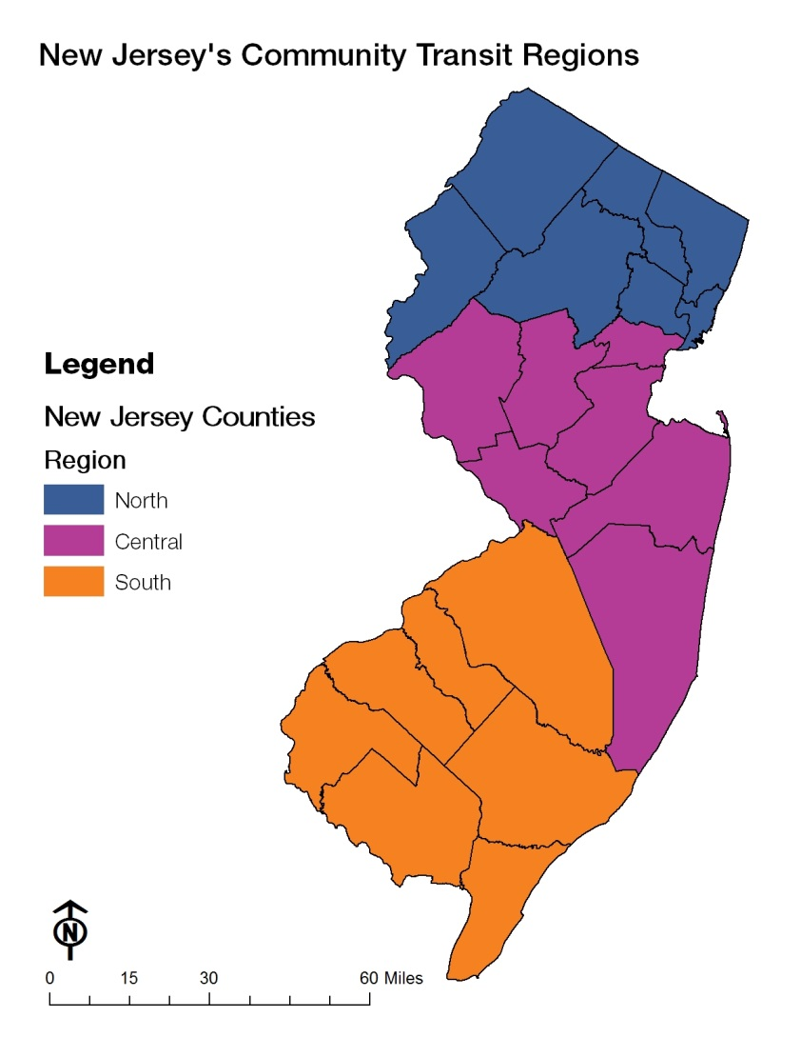
State Regions
Three main regions
North
Central
South

Slide 13
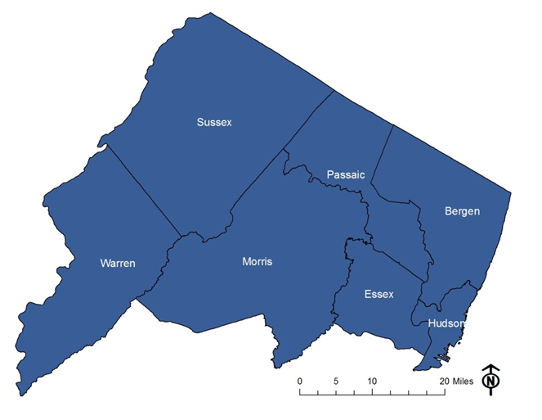
Northern Region
 | Regional Trip Purpose Report for All Programs 2016
 |  | Medical | NC-Emp. | C-Emp. | Recreation | Education | Nutrition | Shop |  |  | Other | Total Trips
 | BERGEN | 65,009 | 58,260 | 10,490 | 27,839 | 45,578 | 65,245 | 20,625 |  |  | 4,214 | 297,260
 | ESSEX | 15,377 | 22,965 | 153,240 | 7,534 | 781 | 11,758 | 3,936 |  |  | 1,206 | 216,797
 | HUDSON | 60,909 | 5,384 | 11,849 | 14,159 | 481 | 4,680 | 1,945 |  |  | 1,256 | 100,663
 | MORRIS | 24,576 | 20,128 | 12,169 | 701 | 4,428 | 1,464 | 1,238 |  |  | 6,499 | 71,203
 | PASSAIC | 36,933 | 12,102 | 21,336 | 20,361 | 1,255 | 31,773 | 10,705 |  |  | 15,359 | 149,824
 | SUSSEX | 16,224 | 10,760 | 27,549 | 346 | 2,184 | 2,591 | 6,734 |  |  | 37,764 | 104,152
 | WARREN | 22,068 | 14,953 | 4,652 | 2,390 | 481 | 12,480 | 2,113 |  |  | 119,662 | 178,799
 | Total: | 241,096 | 144,552 | 241,285 | 73,330 | 55,188 | 129,991 | 47,296 |  |  | 185,960 | 1,118,698

Slide 14
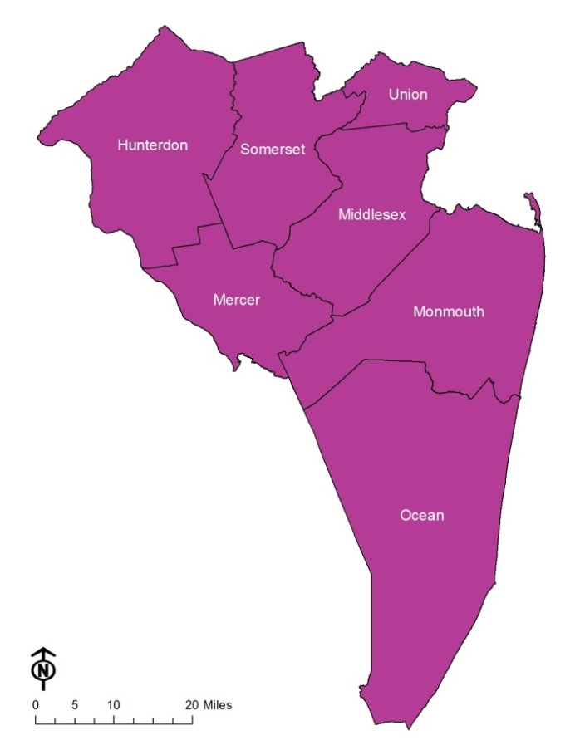
Central Region
 | Regional Trip Purpose Report for All Programs 2016
 |  | Medical | NC-Emp. | C-Emp. | Recreation | Education | Nutrition | Shop |  |  | Other | Total Trips
 | HUNTERDON | 12,421 | 28,161 | 19,741 | 7,500 | 578 | 0 | 6,445 |  |  | 62,177 | 137,023
 | MERCER | 32,231 | 981 | 10,828 | 4,784 | 2,252 | 48,212 | 13,175 |  |  | 31,392 | 143,855
 | MIDDLESEX | 54,563 | 26,281 | 80,764 | 14,007 | 27,388 | 3,796 | 54,121 |  |  | 96,187 | 357,107
 | MONMOUTH | 25,598 | 64,312 | 1,363 | 2,582 | 510 | 17,016 | 17,249 |  |  | 0 | 128,630
 | OCEAN | 48,125 | 12,590 | 3,755 | 0 | 2,856 | 0 | 9,403 |  |  | 165,536 | 242,265
 | SOMERSET | 82,297 | 79,540 | 11,757 | 6,081 | 13 | 45,164 | 11,093 |  |  | 153,961 | 389,906
 | UNION | 60,123 | 39,233 | 71,978 | 6,213 | 993 | 11,466 | 2,719 |  |  | 9,853 | 202,578
 | Total: | 315,358 | 251,098 | 200,186 | 41,167 | 34,590 | 125,654 | 114,205 |  |  | 519,106 | 1,601,364

Slide 15
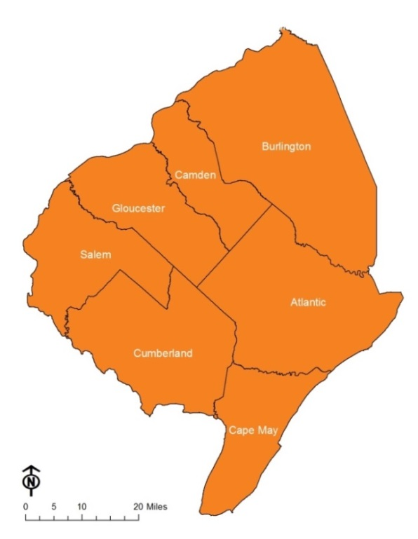
Southern Region
 | Regional Trip Purpose Report for All Programs 2016
 | 2016 CASINO South Region
 |  | Medical | NC-Emp. | C-Emp. | Recreation | Education | Nutrition | Shop |  |  | Other | Total Trips
 | ATLANTIC | 33,254 | 977 | 4,233 | 5,022 | 431 | 51,705 | 14,706 |  |  | 9,090 | 119,418
 | Burlington (SCUCS) | 12,297 | 0 | 2,429 | 0 | 0 | 7,980 | 7,973 |  |  | 0 | 30,679
 | CAMDEN (SCUCS) | 25,345 | 81,129 | 6,733 | 5,197 | 2 | 3,386 | 11,725 |  |  | 1,200 | 134,717
 | CAPE MAY | 31,096 | 26,921 | 7,483 | 8,478 | 627 | 21,139 | 9,799 |  |  | 11,881 | 117,424
 | CUMBERLAND | 24,870 | 7,704 | 5,415 | 5,066 | 732 | 9,134 | 8,161 |  |  | 81,854 | 142,936
 | GLOUCESTER | 21,259 | 14,733 | 2,735 | 0 | 4,259 | 0 | 1,856 |  |  | 488 | 45,330
 | SALEM | 8,681 | 1,621 | 1,190 | 141 | 50 | 524 | 919 |  |  | 1,317 | 14,443
 | Total: | 156,802 | 133,085 | 30,218 | 23,904 | 6,101 | 93,868 | 55,139 |  |  | 105,830 | 604,947

Slide 16
Local Programs, Minibus Support and Community Transportation Contacts
Contact | Title | Phone | Email
Anna R. Magri | Director, Local Programs and Minibus Support and Community Transportation | (973) 491-7381 | AMagri@njtransit.com
Gloria Velez | Senior Secretary | (973) 491-8767 | GVelez@njtransit.com
 | Manager of Community Transportation | Contact Anna Magri | Contact Anna Magri
Elaine Restaino | Assistant Planner for Community Transportation | (973) 491-7372 | ERestaino@njtransit.com
 | Community Transportation Grants Administrator – NJ-JARC and New Freedom | Contact Anna Magri | Contact Anna Magri
Fred Storey | Community Transportation Grants Administrator – CMAQ shuttles and capital, TMAs, Bike lockers and Van Pools | (973) 491-8569 | FStorey@njtransit.com
Janelle Rivera | Manager of Local Programs – SCDRTAP, Section 5310 and Section 5311 | (973) 491-8346 | JRivera1@njtransit.com
Brian Joseph Miguel | Regional Program Assistant Local Programs | (973) 491-8576 | BMiguel@njtransit.com
Isabel Hernandez | Northern Regional Program Administrator (Bergen, Hudson, Essex, Morris, Passaic, Sussex, Warren) | (973) 491-7456 | ILernandez@njtransit.com
Lauren Williams | Central Regional Program Administrator (Hunterdon, Mercer, Middlesex, Monmouth, Ocean, Somerset, Union) | (973) 491-7374 | LNwilliams@njtransit.com
Lisa Tulley | Southern Regional Program Administrator (Atlantic, Burlington, Camden, Cape May, Cumberland, Gloucester, Salem) | (973) 491-8397 | LTulley@njtransit.com
Lea Sheridan | Supervisor of Minibus Safety Equipment – training and Drug and Alcohol program | (973) 491-8043 | LSheridan@njtransit.com
William Veniscofski | Quality Assurance Specialist – vehicle inspector | (973) 491-7368 | WVeniscofski@njtransit.com
Lisa Veloz | Quality Assurance Specialist – vehicle inspector | (973) 491-8018 | LVeloz@njtransit.com
Chris Uffer | Warranty Administrator | (973) 491-7986 | CUffer@njtransit.com

